Slide 1

Social Network Analysis & Visualisation #SHDB17 Ellen König, Syennie Valeria, Thomas Beutin
Notes:
11/19/17
1
1

Slide 2
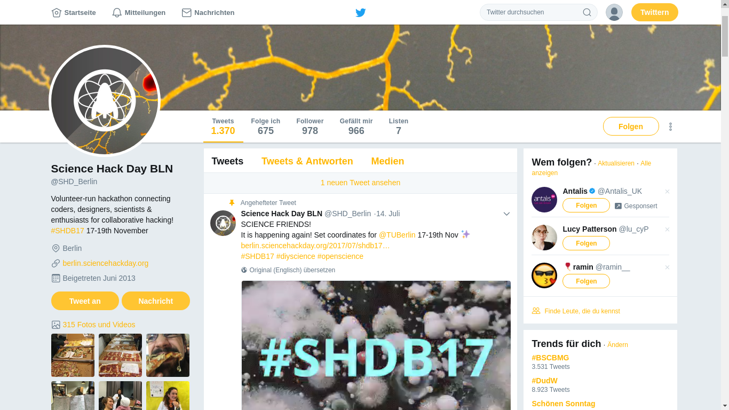
Notes:
11/19/17
2
2

Slide 3
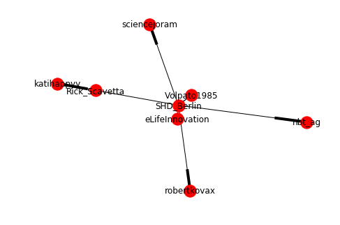
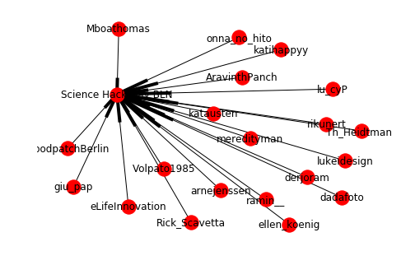
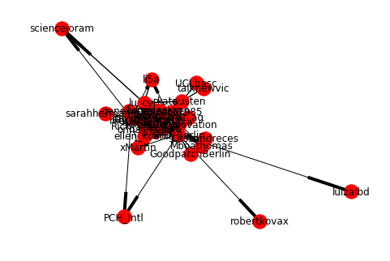
Notes:
11/19/17
3
3

Slide 4
Notes:
11/19/17
4
4

Slide 5
Betweenness Centrality
Closeness Centrality
Out-Degree Centrality
In-Degree Centrality

